Slide 1

Word2Vec - Baby Version 2

Slide 2
Reference
aneesh joshi’s Blog, Code, and related Jupyter_Notebook
Zak Jost’s Blog on Noise Contrastive Estimation
NCE Paper
Chapter 14 (O'Reilly) of Hands-On ML
Youtube on Dataset used in this presentation
Youtube on Word2Vec Baby Version
Youtube
Code

Slide 3
Data

Slide 4
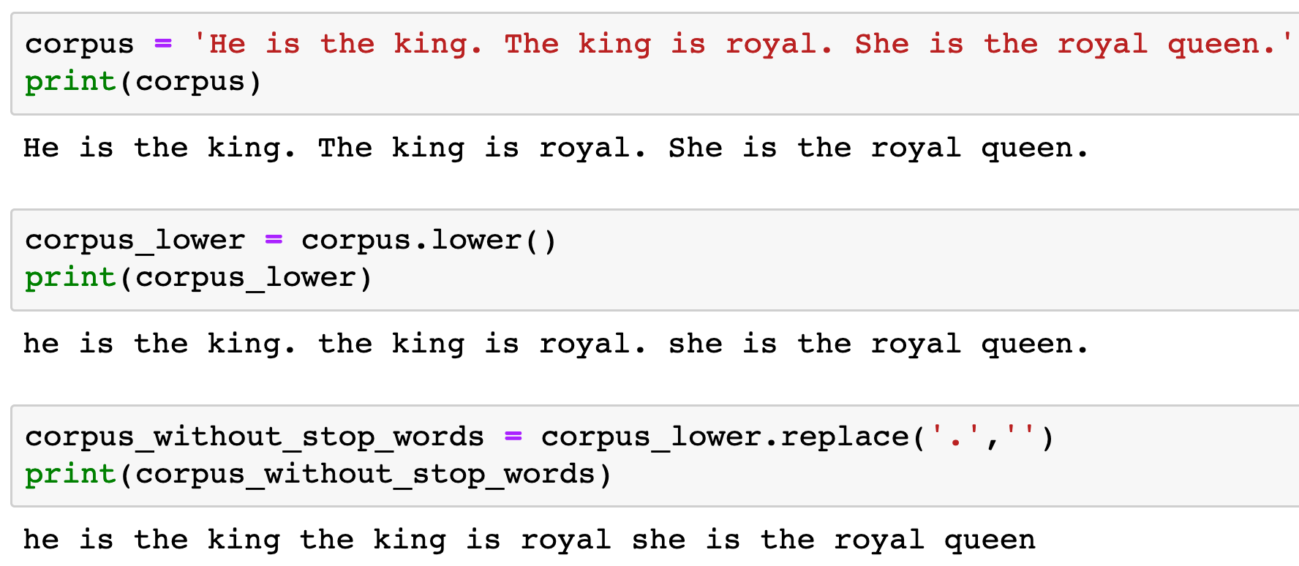


Slide 7
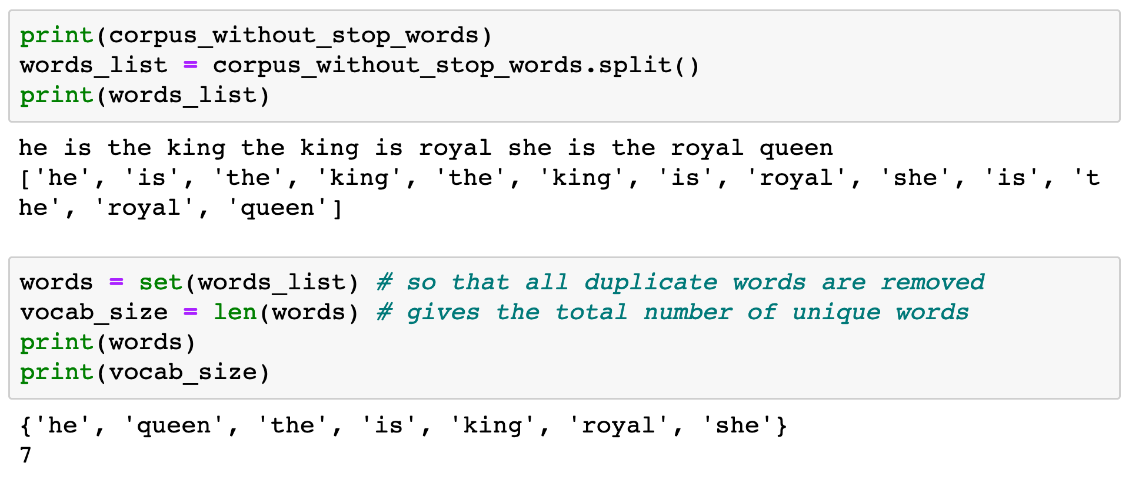


Slide 9
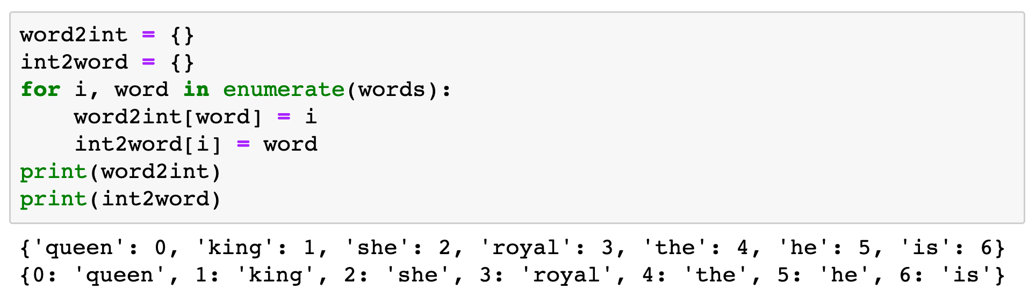

Slide 10
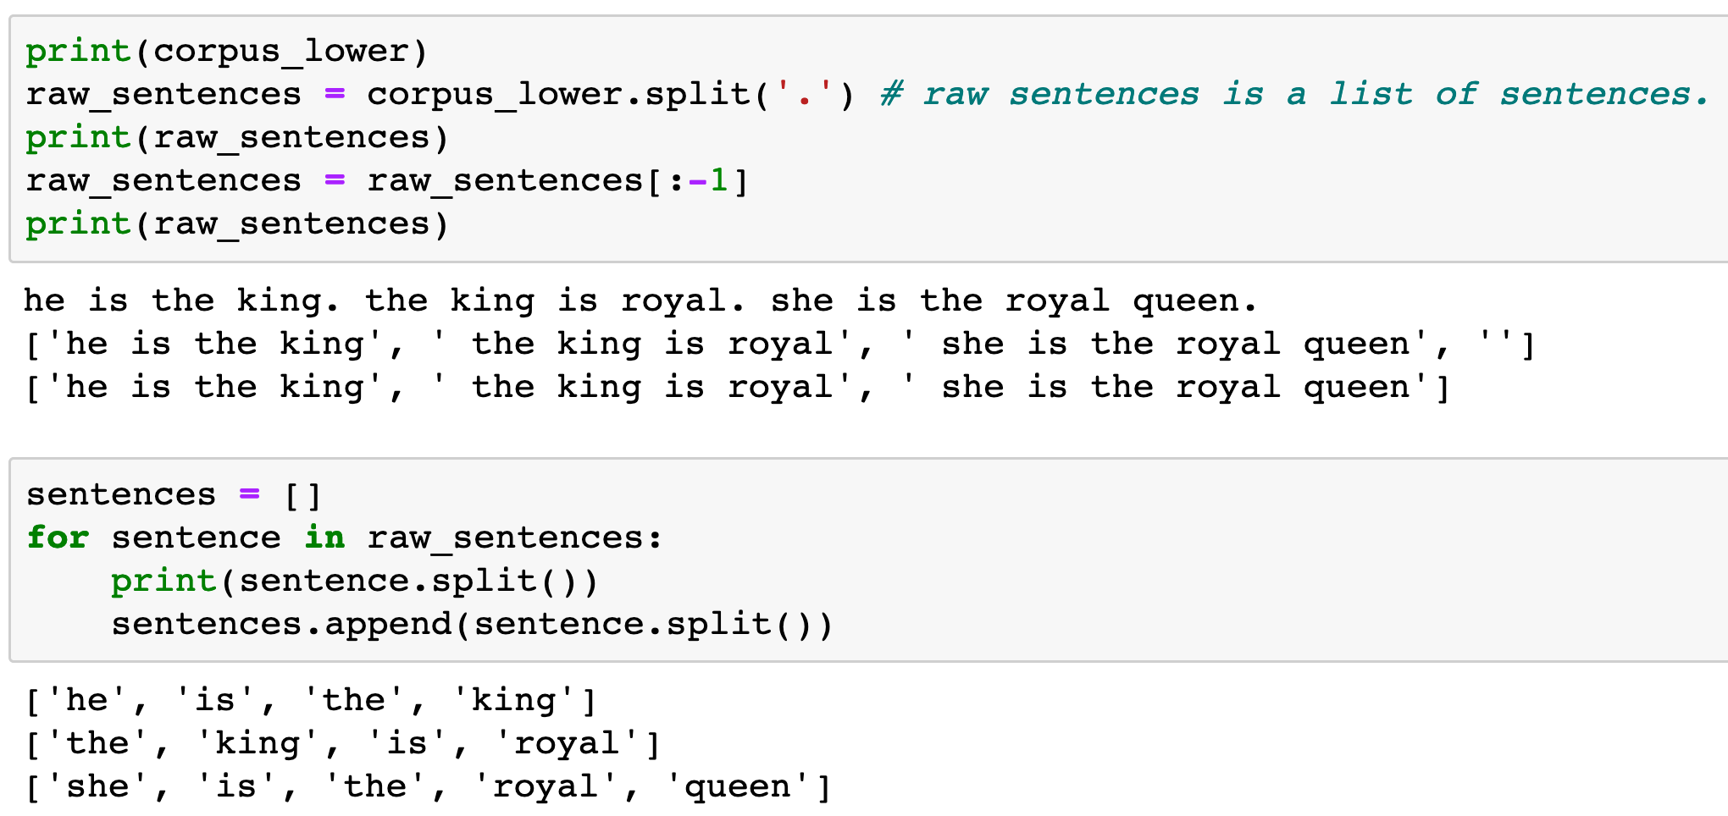

Slide 12
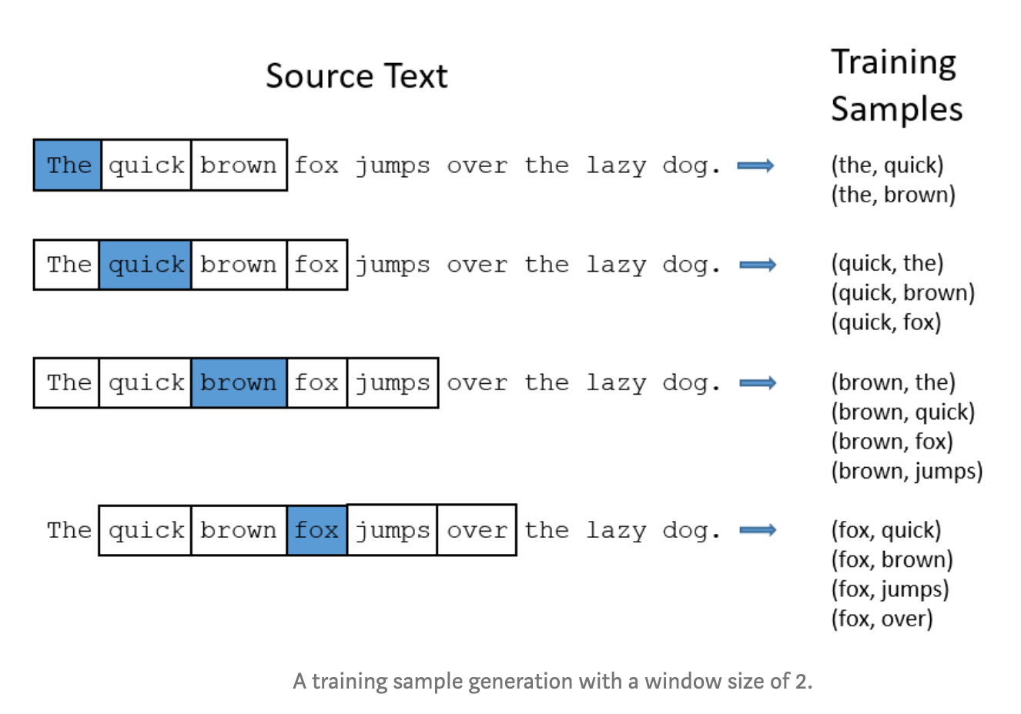
aneesh joshi’s Blog

Slide 13
aneesh joshi’s Blog
target word

Slide 14
aneesh joshi’s Blog
target word
context word

Slide 15
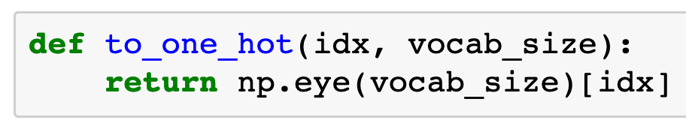

Slide 16
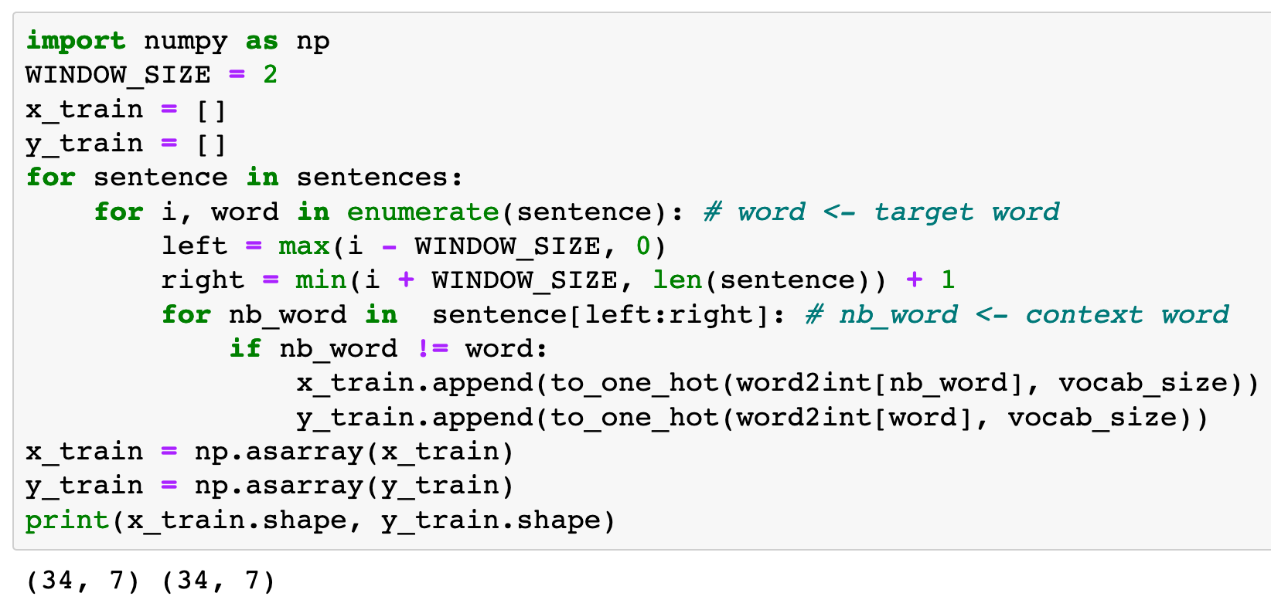
Previously

Slide 17
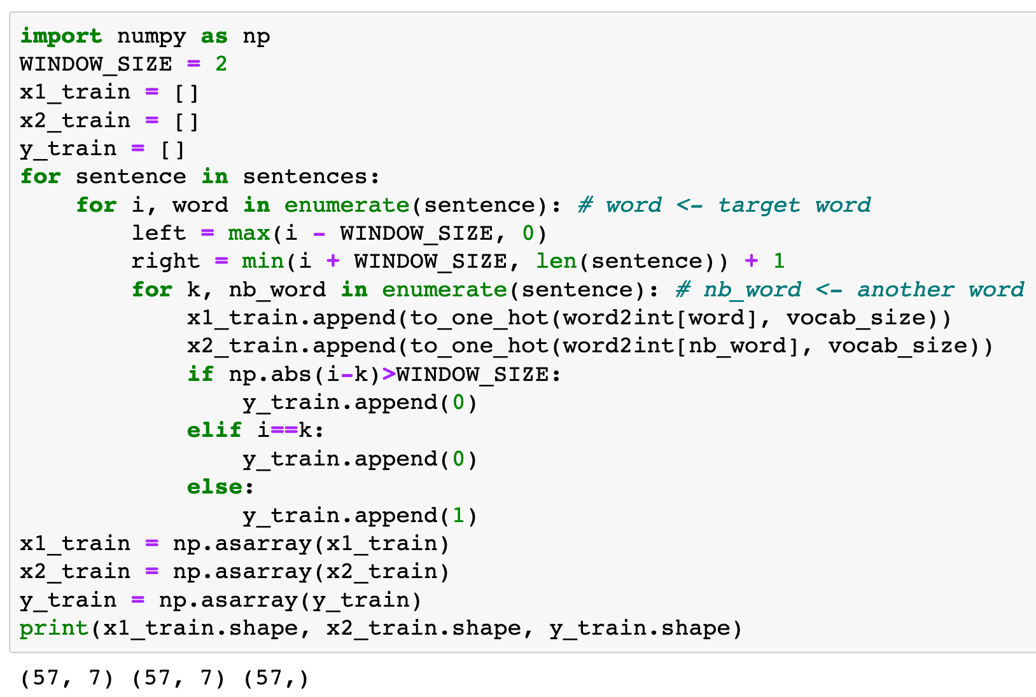
Now

Slide 18

Previously
x: context word in one hot
y: target word in one hot
Now
x: possible context word and target word in one hot
y: 0 (negative sampling) and 1 (positive sampling)

Slide 19
Previously
x: context word in one hot
y: target word in one hot
Now
x: possible context word and target word in one hot
y: 0 (negative sampling) and 1 (positive sampling)

Slide 20
Previously
x: context word in one hot
y: target word in one hot
Now
x: possible context word and target word in one hot
y: 0 (negative sampling) and 1 (positive sampling)

Slide 21
Previously
x: context word in one hot
y: target word in one hot
Now
x: possible context word and target word in one hot
y: 0 (negative sampling) and 1 (positive sampling)

Slide 22
Previously
x: context word in one hot
y: target word in one hot
Now
x: possible context word and target word in one hot
y: 0 (negative sampling) and 1 (positive sampling)

Slide 23
Previously
x: context word in one hot
y: target word in one hot
Now
x: possible context word and target word in one hot
y: 0 (negative sampling) and 1 (positive sampling)

Slide 24
Now
target word

Slide 25
Now
target word
another word, possibly context word

Slide 26
Now
target word
another word, possibly context word
Negative Sampling

Slide 27
Now
target word
another word, possibly context word
Negative Sampling
Negative Sampling

Slide 28
Now
target word
another word, possibly context word
Negative Sampling
Negative Sampling
Positive Sampling

Slide 29
Graph

Slide 30
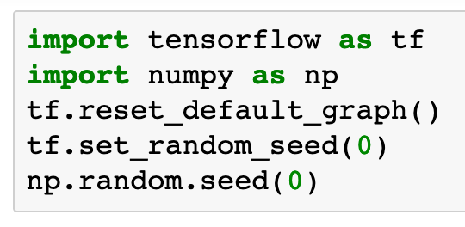

Slide 31

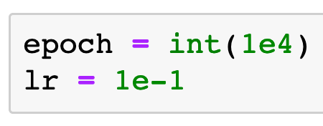

Slide 32
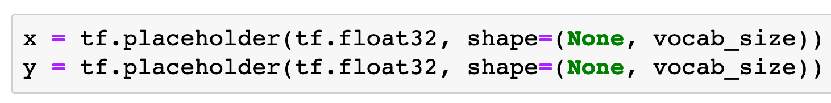
Previously

Slide 33
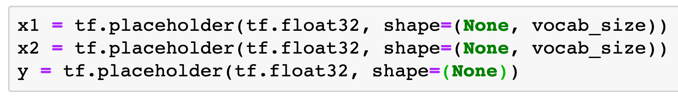
Previously
Now

Slide 34
Previously
Now
Placeholder for target word in one hot encoding

Slide 35
Previously
Now
Placeholder for target word in one hot encoding
Placeholder for another word in one hot encoding

Slide 36
Previously
Now
Placeholder for target word in one hot encoding
Placeholder for another word in one hot encoding
Placeholder for 0 (negative sampling) and 1 (positive sampling)

Slide 37
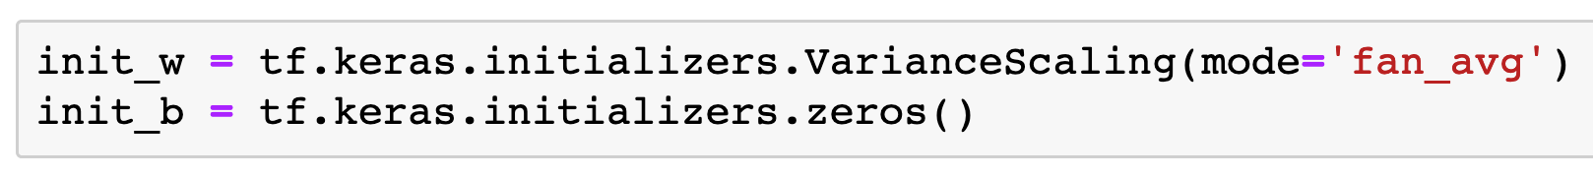

Slide 38
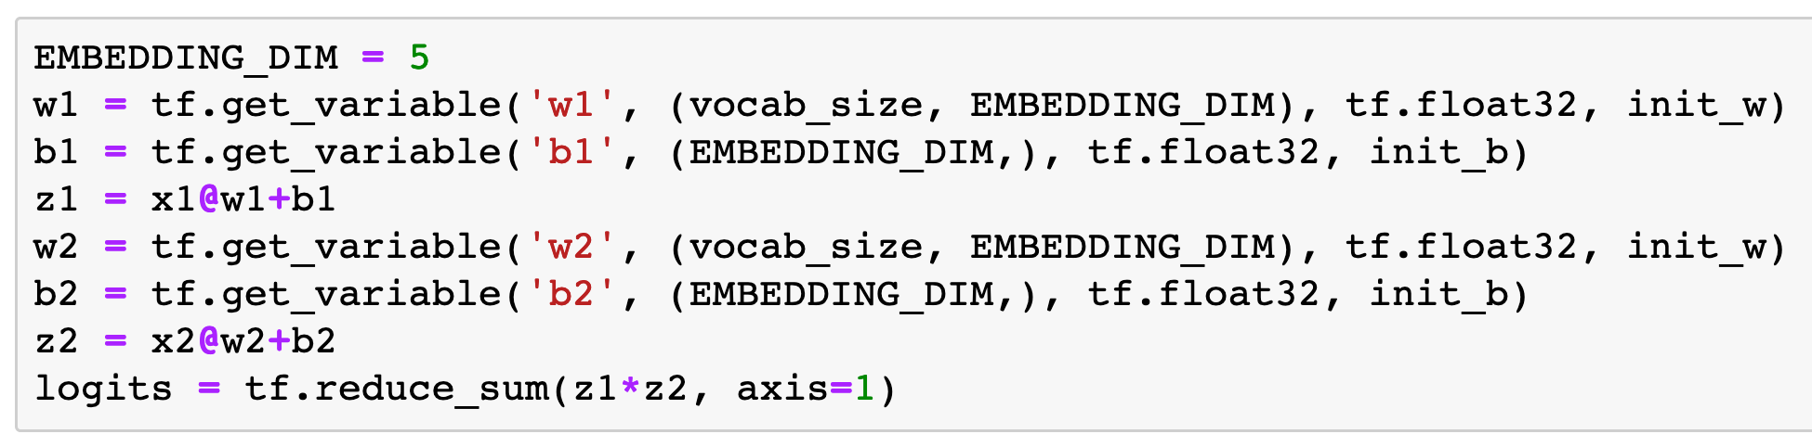

Slide 39
Target
Embedding

Slide 40
Target
Embedding
Another
Parameterization

Slide 41
Target
Embedding
Another
Parameterization
Inner Product

Slide 42
Target word in one hot encoding
Target
Embedding
Another
Parameterization
Inner Product

Slide 43
Target word in one hot encoding
Another word in one hot encoding
Target
Embedding
Another
Parameterization
Inner Product

Slide 44
Target word in one hot encoding
Another word in one hot encoding
Target
Embedding
Another
Parameterization
Inner Product
0 (negative sampling) or 1 (positive sampling)

Slide 45
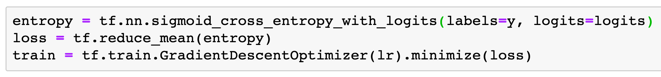

Slide 46
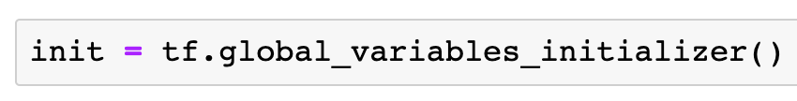

Slide 47
Session

Slide 48
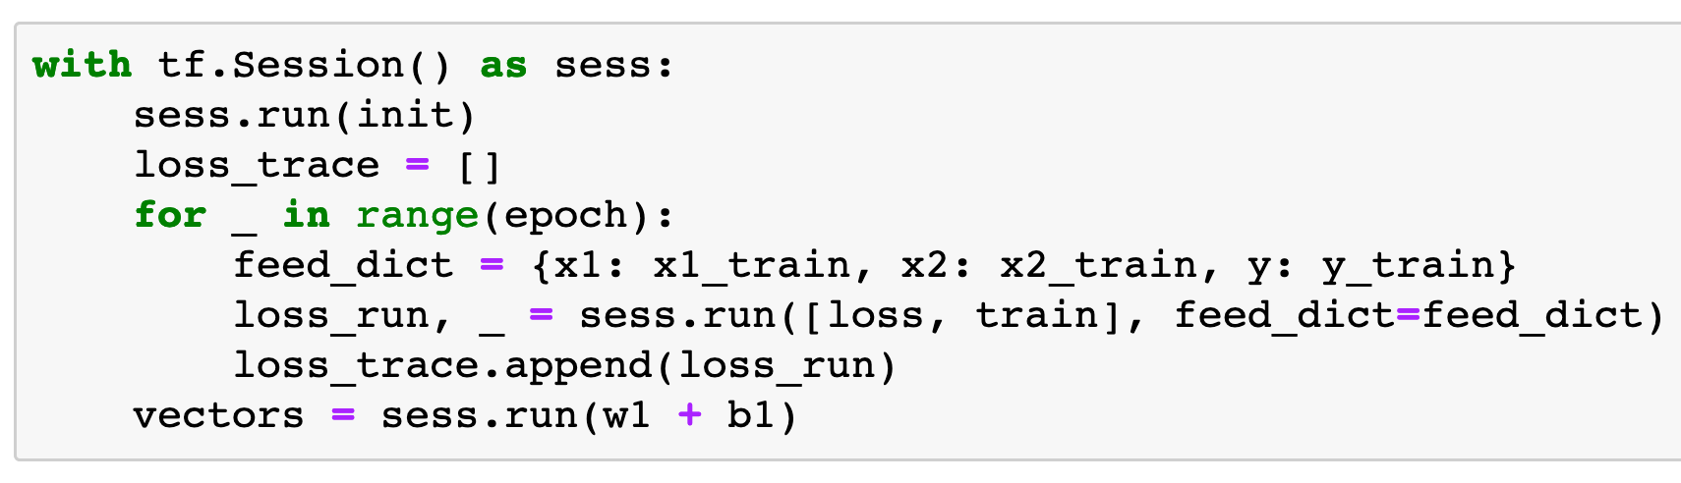
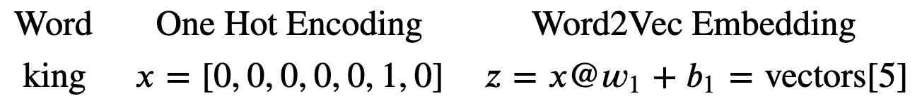
Word2Vec
Embedding

Slide 49
Word2Vec
Embedding

Slide 50
Word2Vec
Embedding

Slide 51
Word2Vec
Embedding

Slide 52
Word2Vec
Embedding

Slide 53
Report

Slide 54
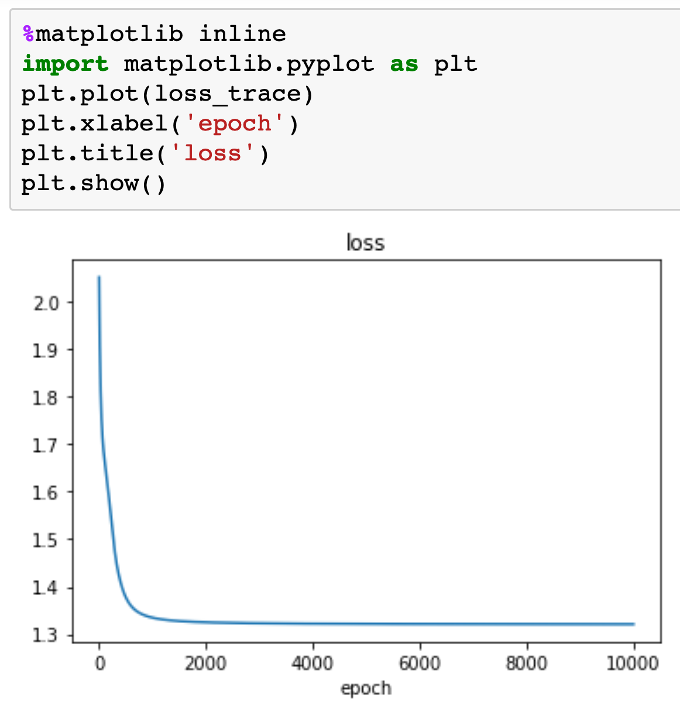

Slide 55
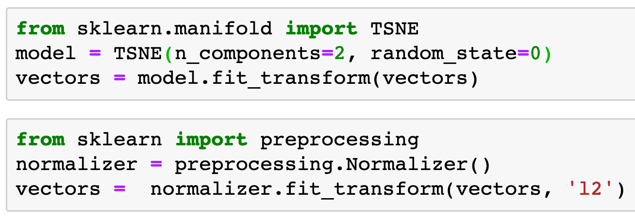


Slide 57
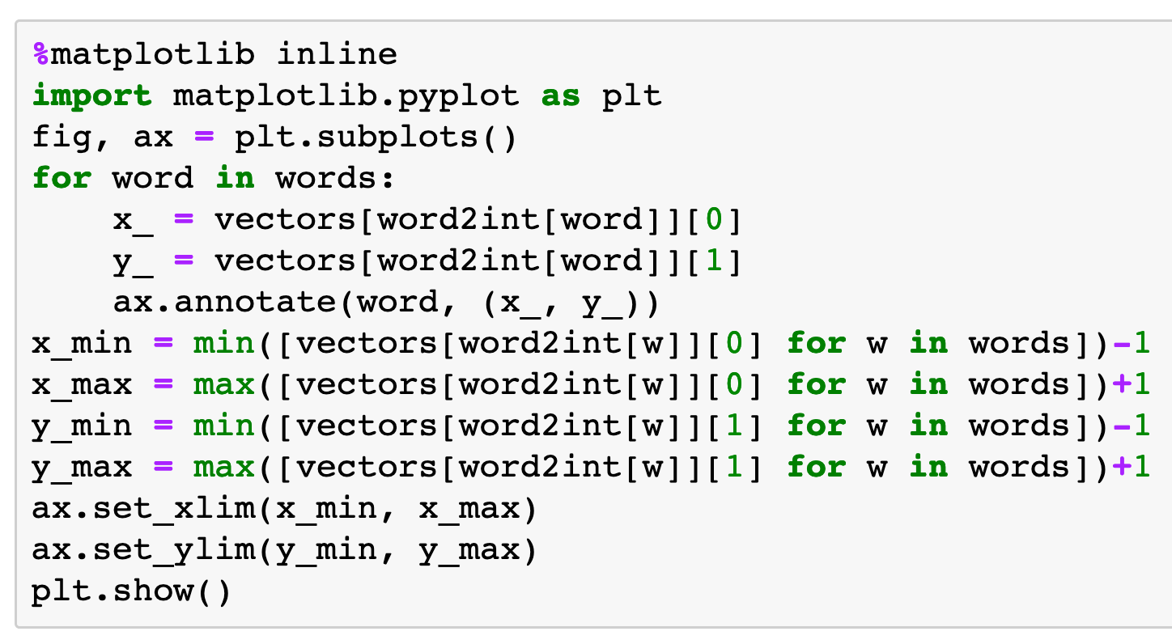

Slide 58
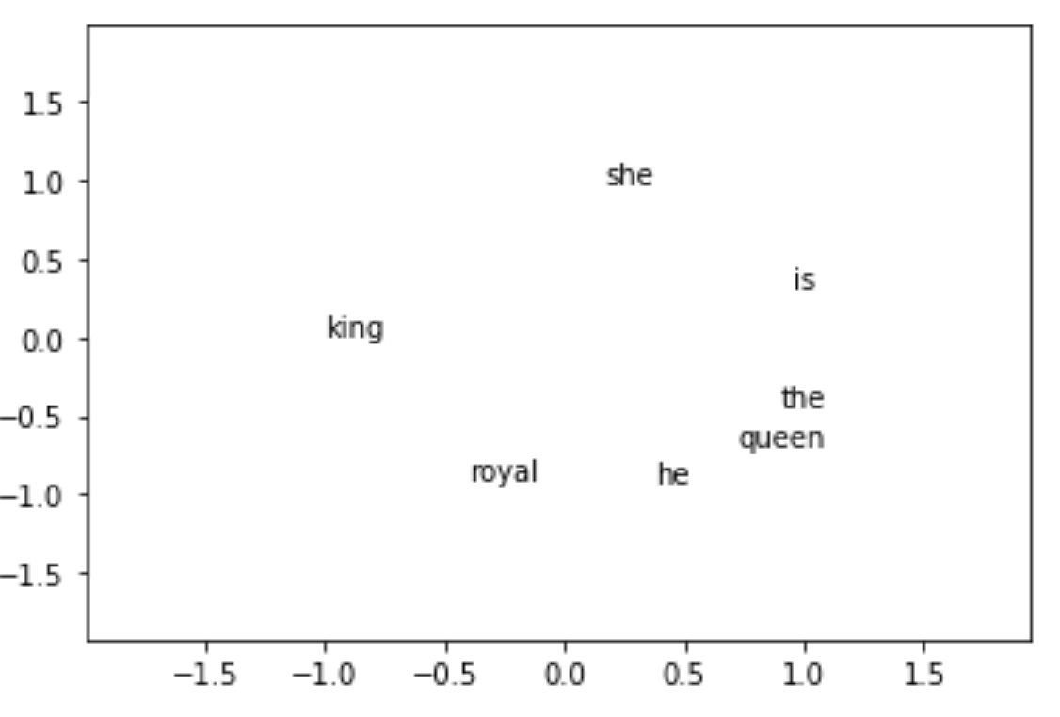

Slide 59
Now
Let’s Play with Code

